Slide 1
Presentation 25th April 2024
Jenny England, Martin Robertson & David Ross

Slide 2
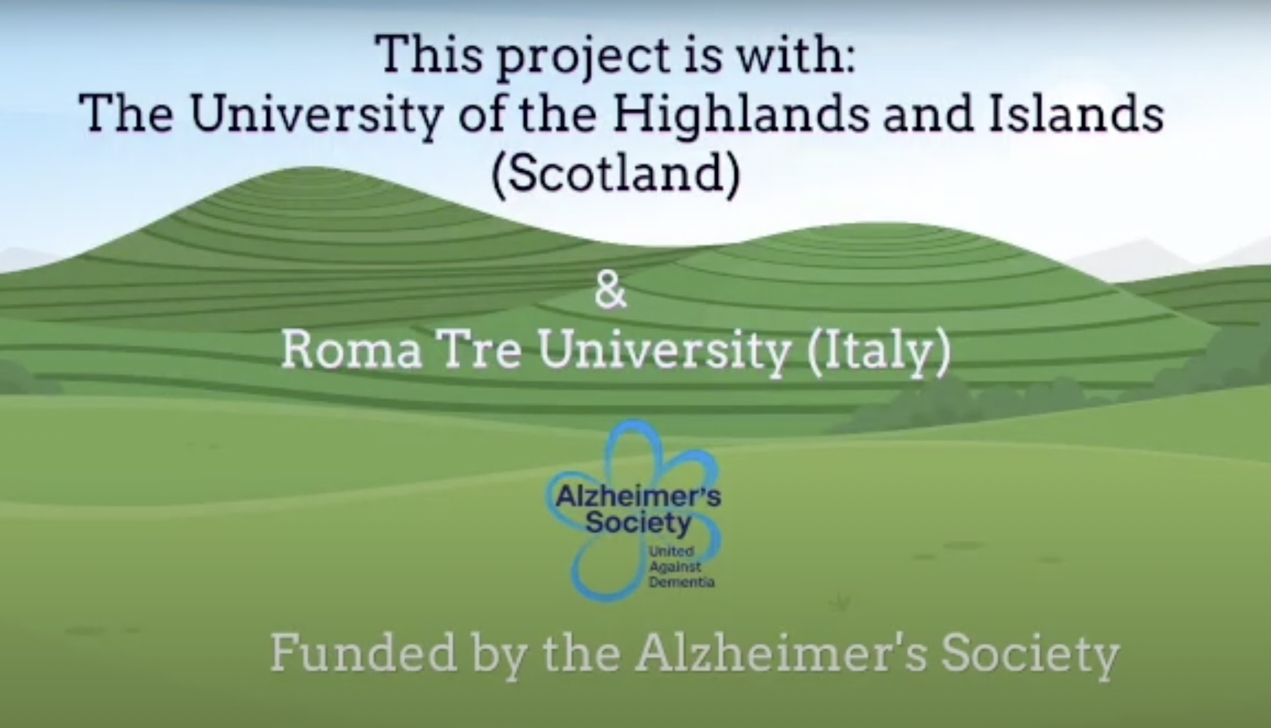

Slide 41
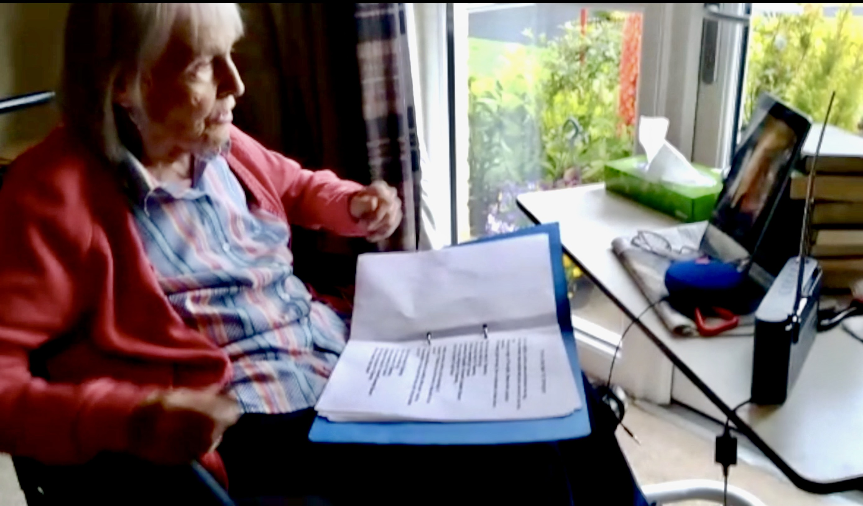
Collaboration and Partnering stages
Pre-funding: Initial informal experimentation in a care home which included
conversations with the care home manager and those with lived experience.
2. Partners in research to get feedback on study design before funding application
3. After funding secured, a Partners in Research group formed, which met approximately every 2-3 weeks for the
first 6 months and continues to meet as and when needed.
4. A partners group 2 formed consisting of of movement and music specialists who work with persons
living with dementia
5. Phase 1 of the study participants feed into design and dissemination

Slide 42
PiR group 1
Phase 1. design, methods, ethics
Phase 2: analysis and dissemination
Fieldwork with participant feedback on design and analysis
Modifications and ethical amendments for phase 1
Feedback and discussion with PiR group from fieldwork
Analysis and dissemination with PiR group and participants

Slide 43
The Pros and Cons of partnering and collaborating
PROS:
An added wealth of experience and knowledge
Improves quality of the research
Diverse perspectives
Meaningful input
Enhances relevance and equity in research
Building of relationships and networks
Companionship and community

Slide 44
CONS:
Time burden within the framing of a PhD study
Acknowledgement from funders that good PPI takes time
Ultimately in a PhD study the PhD student is responsible for the research
Ethical issues can be a barrier to involving partners in all aspect of the research

Slide 45
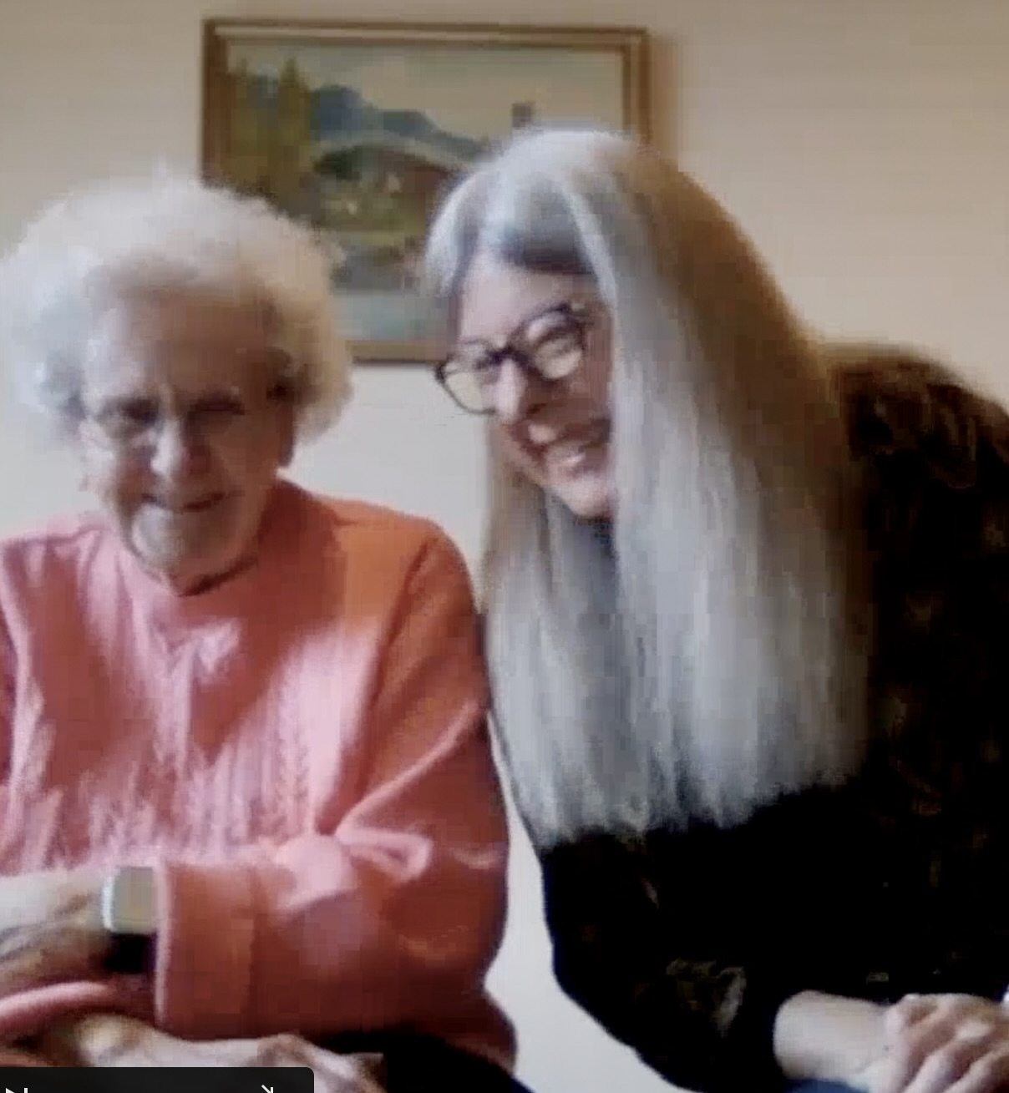
RECRUITMENT ISSUES IN RURAL SCOTLAND
What has been most effective?
Gatekeepers?
Dementia related organisations?
Social media and local press?
Events?
In-person attendance at local groups?
Direct contact with care homes?

Slide 46
Initial findings from case study 1
Intimate time together in their own home
A meaningful activity they could do without leaving the house
Reciprocal engagement: leading the activity and in music choices
Playful and joyful “It’s like re-discovering your inner child”
Creative and expressive “it’s brought both of us out our shells” “Whatever you do it’s not wrong, it’s liberating” “to see that coming out of my mum is just magic”
Extending the connection to other family members
Stress reduction and energising “I know I’ll feel better by the end of the session”

Slide 47
STUDY WEBSITE
https://musicmovementdementia.com

